Slide 1
Ai Adaptation in
Game Design
By: Brennian Lush

Slide 2
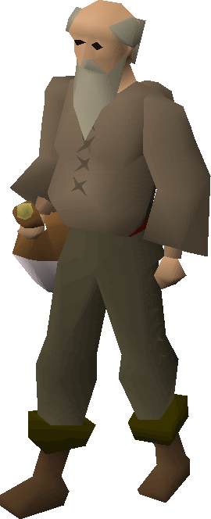
AI in gaming refers to responsive and adaptive video game experiences.
NPCS
  Change based off player actions

Slide 3
AI in gaming is all about enhancing a player’s experience.
AI’s use in games increasingly shift the control of the game experience toward the player
Game data is produced algorithmically rather than every element being built specifically by a developer.

Slide 4
Other aspects include
Image quality enhancement
AI in gaming can assist in game personalization
  Many unique experiences

Slide 5
Some negative aspects might include
As AI gets more advanced, game makers have less control over them.
Originality might be lost
We may get some clunkier games when the AI programming goes awry.

Slide 6
Rather than developers having less control it provides more options
When used correctly it doesn’t diminish originality
Ai can definitely lead to some issues and make a game “clunky,” but this is more the outlier

Slide 7
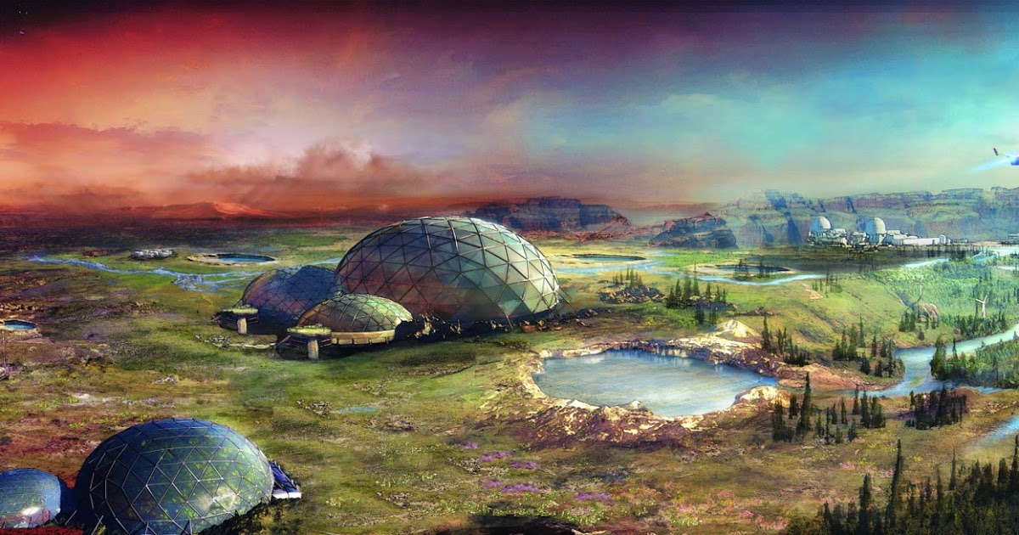
Ai contributes to a better gaming experience in the majority of cases

Slide 8
Sources
https://www.engati.com/blog/ai-in-gaming#toc-what-are-the-types-of-ai-in-games-
https://www.pocketgamer.biz/feature/81677/the-role-of-ai-in-games-development-part-one-an-overview/#:~:text=AI%20tools%20can%20create%20more,also%20enhance%20sound%20in%20games.
https://singularityhub.com/2019/02/10/what-games-are-humans-still-better-at-than-ai/
https://www.gamedesigning.org/gaming/ai-in-gaming/
https://www.analyticsvidhya.com/blog/2023/03/ml-and-ai-in-game-development/#:~:text=Frequently%20Asked%20Questions-,What%20are%20ML%20and%20AI%20Used%20for%20in%20Game%20Development,controlled%20characters%20in%20video%20games.
https://www.incredibuild.com/blog/artificial-intelligence-in-game-development-the-top-6-ai-tools-you-need-now

